Slide 1

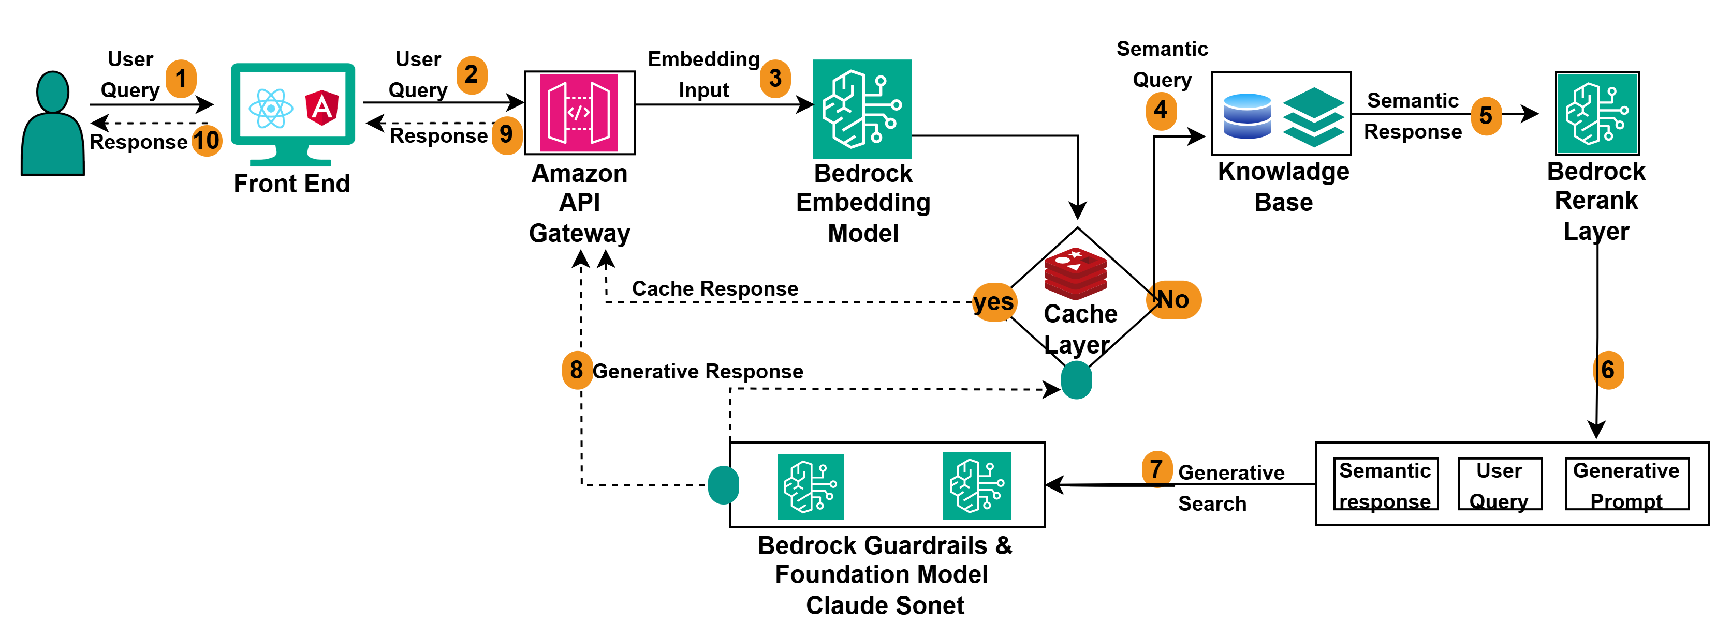
What is the Llama Model?
AWS RAG Architecture
Llama (Large Language Model Meta AI) is a series of open-source language models developed by Meta (previously Facebook). These models are designed to understand and generate human-like text based on the input provided to them. They are trained on vast datasets and are capable of performing a variety of NLP (Natural Language Processing) tasks, such as text generation, summarization, translation, and question answering.
Llama models are designed to be efficient and offer high performance, allowing for cost-effective deployments in a variety of real-world applications, from chatbots to content generation systems.
edquest

Slide 2
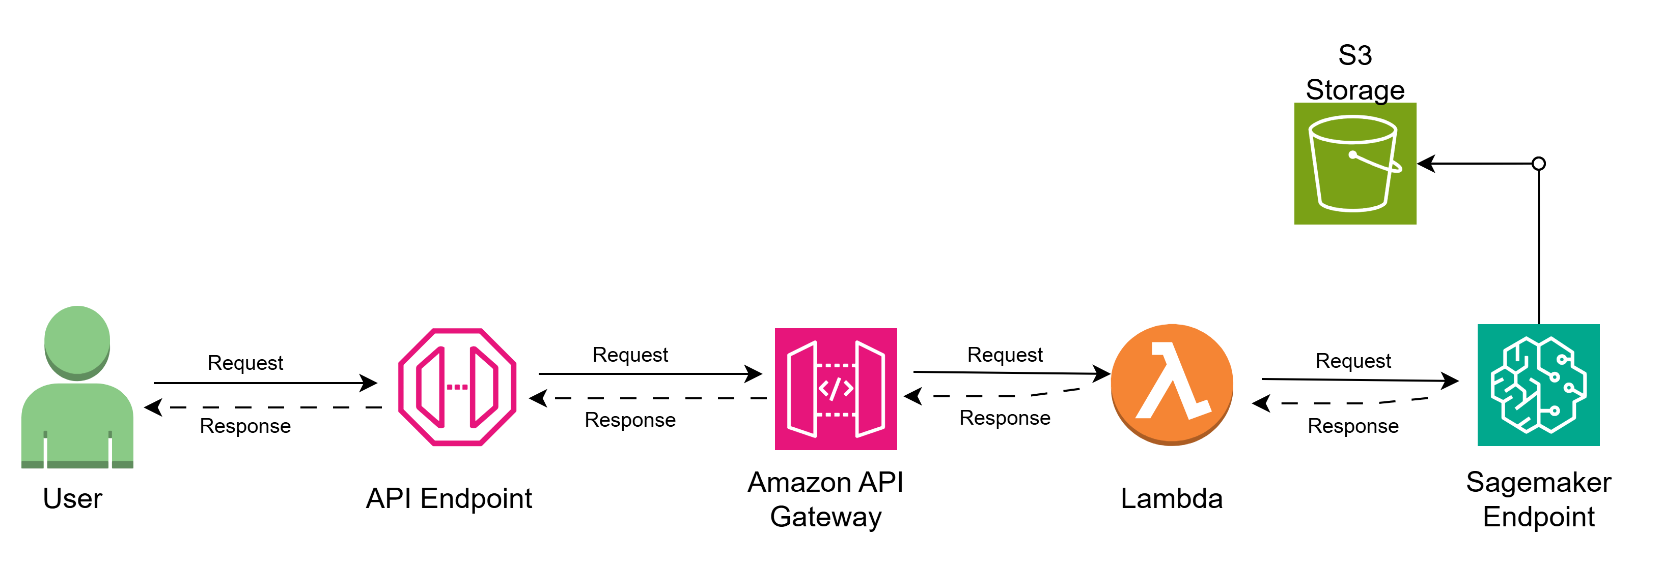
What is the Llama Model?
ML Request/Response Flow
Llama (Large Language Model Meta AI) is a series of open-source language models developed by Meta (previously Facebook). These models are designed to understand and generate human-like text based on the input provided to them. They are trained on vast datasets and are capable of performing a variety of NLP (Natural Language Processing) tasks, such as text generation, summarization, translation, and question answering.
Llama models are designed to be efficient and offer high performance, allowing for cost-effective deployments in a variety of real-world applications, from chatbots to content generation systems.
edquest

Slide 3
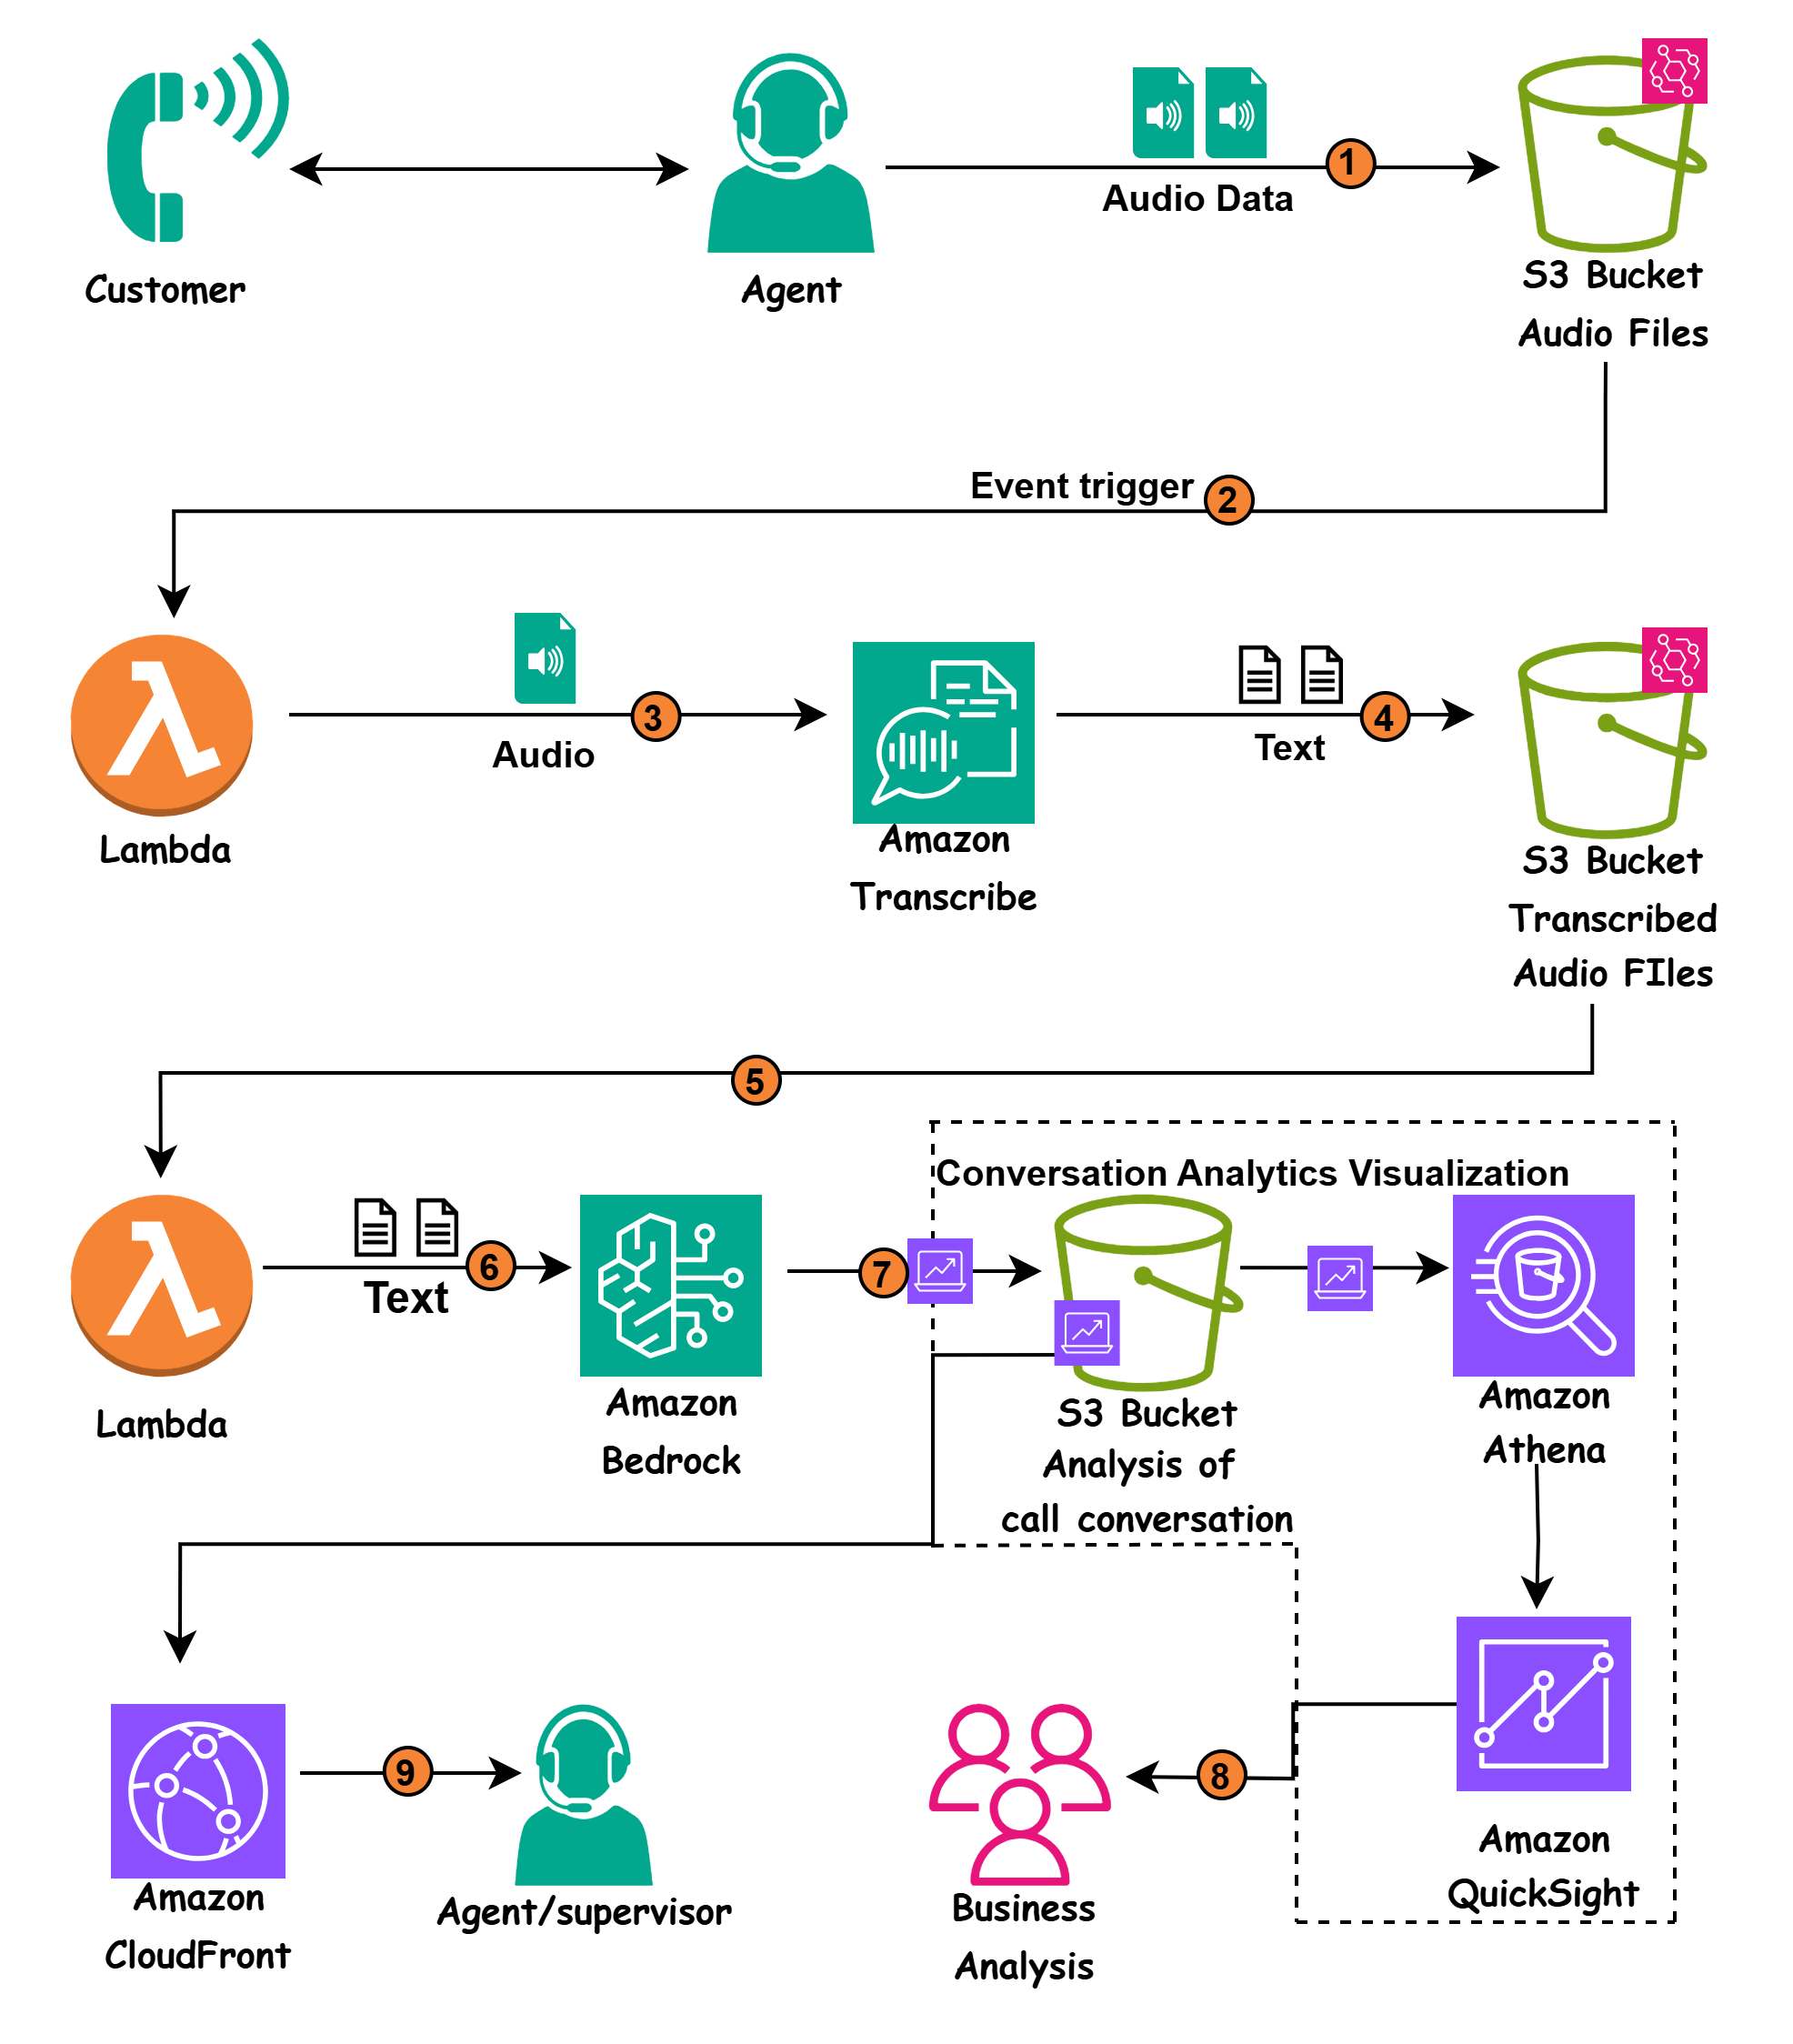
Post Call Analysis Design
What is Llama Model?
edquest

Slide 4
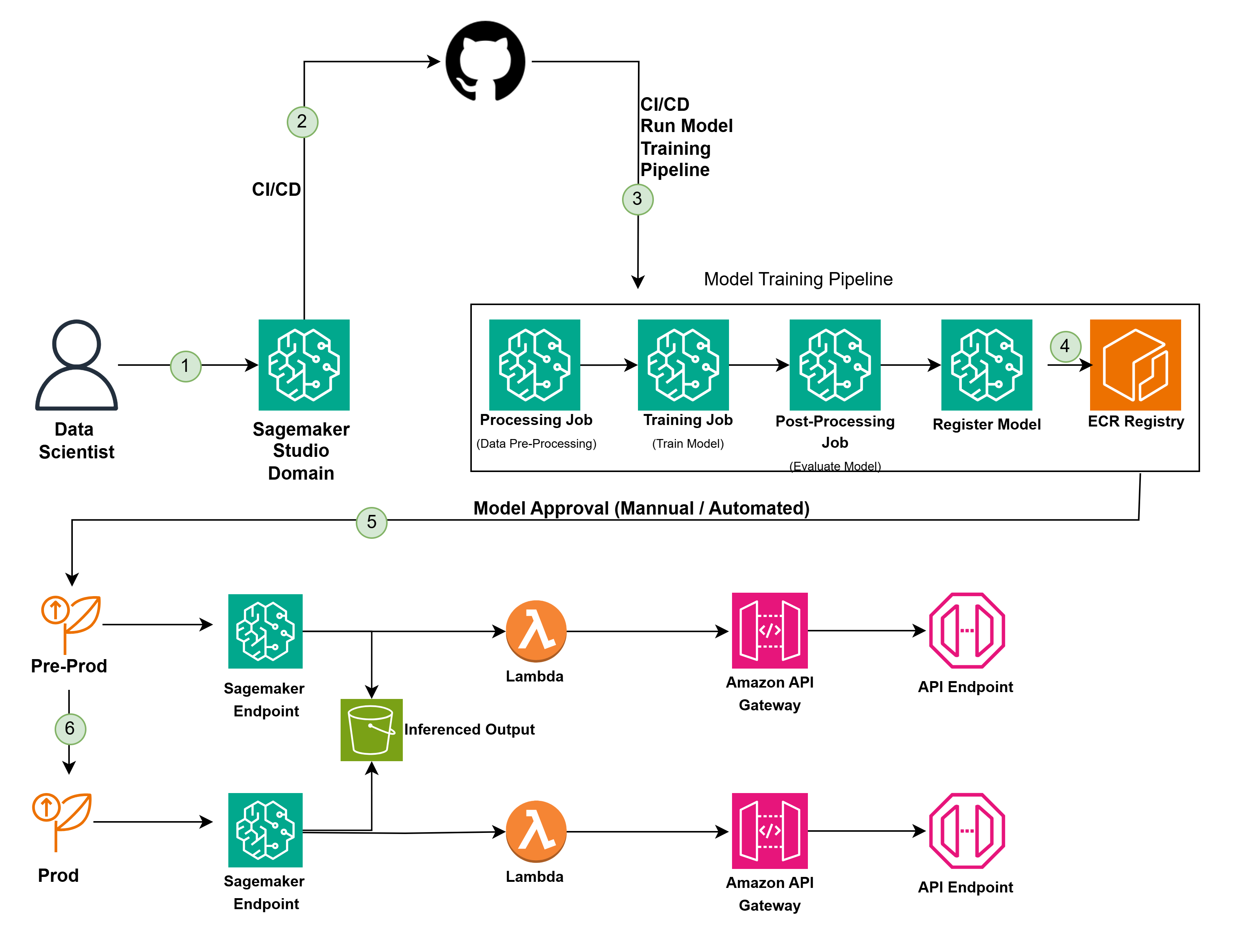
End-to-End
ML model Lifecycle Pipeline
edquest

Slide 5
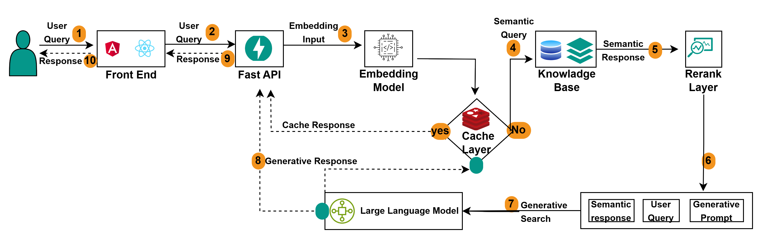
What is the Llama Model?
RAG Architecture
edquest

Slide 6
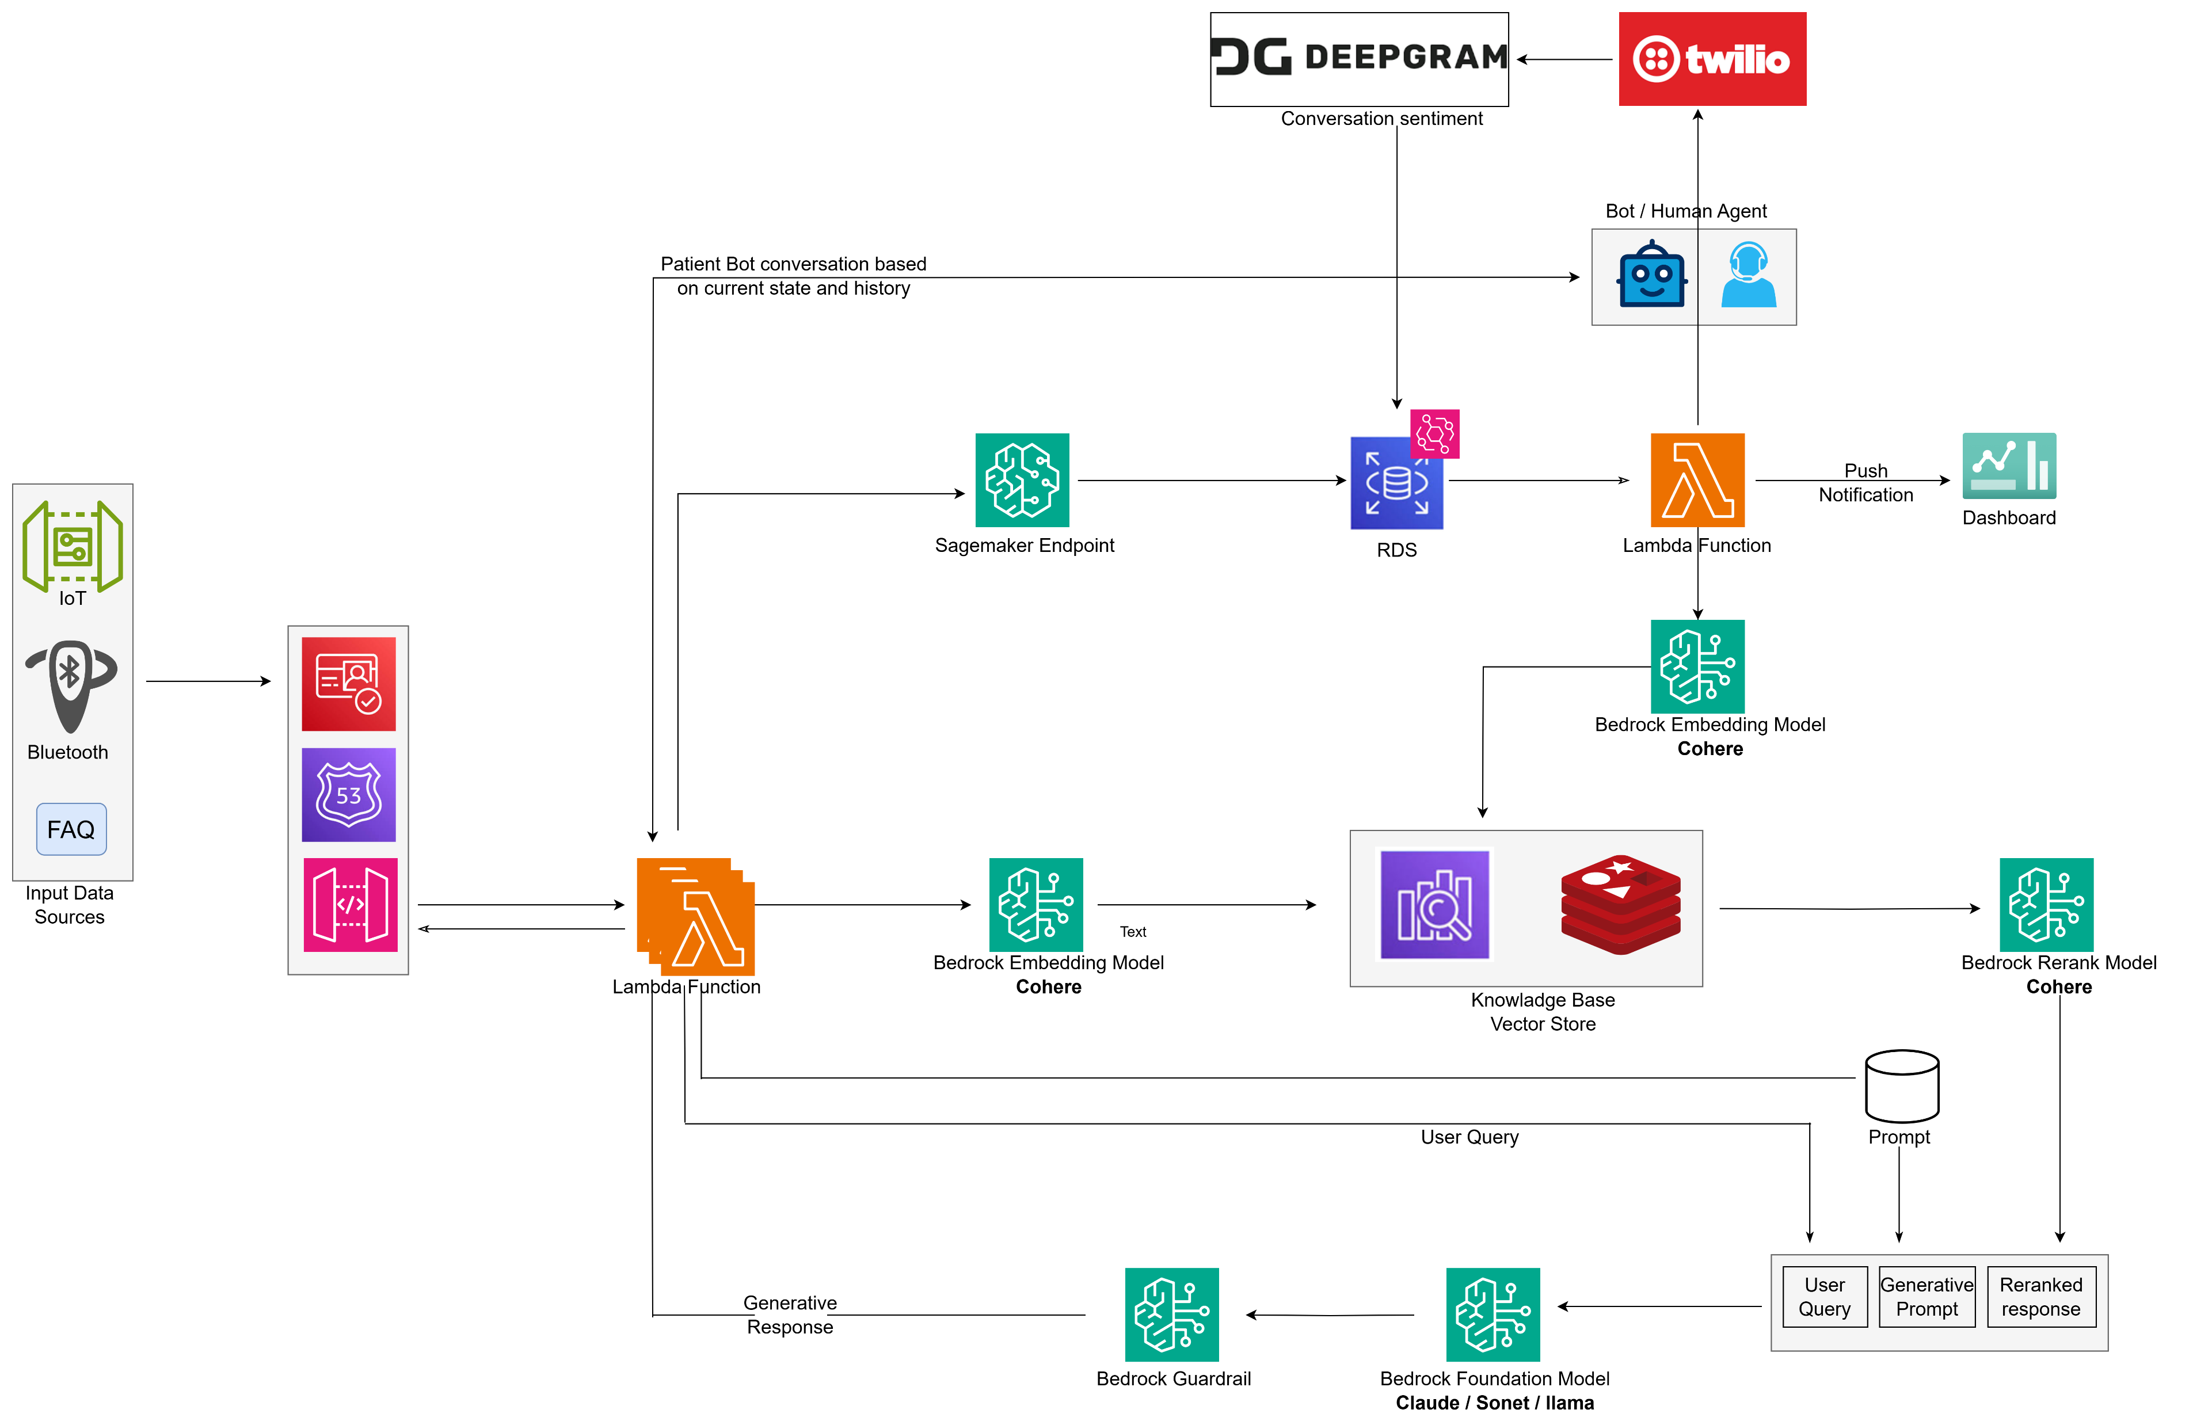
What is the Llama Model?
RPM: Remote Patient Monitoring
System Architecture
edquest

